Slide 1
Demystifying Electromagnetic Simulation:
A Hands-On Session with FEMM

Slide 2
A Hands-On Session with FEMM
What are we gonna learn?
Contents
What are terms “Magnet and Magnetic”?
What are circuits?
What are magnetic circuits?
Simple magnetic circuit
  Understanding a simple magnetic circuit
  Calculating the values
  Understanding practicality
“Finite Element Method Magnetics – FEMM”
  About & Installation
  FEMM – Modelling
  Finite Element Method
  Comparison and understanding the results

Slide 3
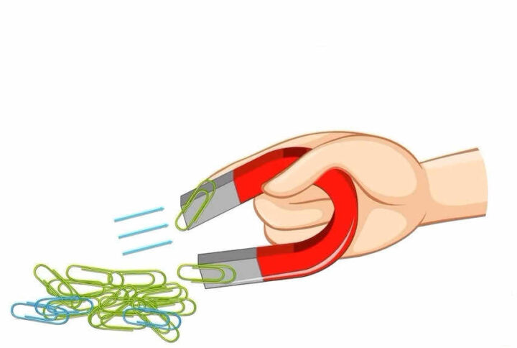
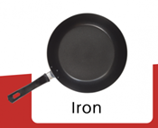

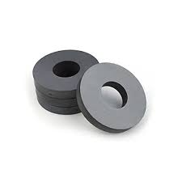

A Hands-On Session with FEMM
What are terms “Magnet and Magnetic”?
Magnet
Magnetic
Note:
Not all magnetic materials are iron
In simple terms:
Anything which attracts iron is a magnet
In simple terms:
Anything which is attracted by a magnet is magnetic material

Slide 4
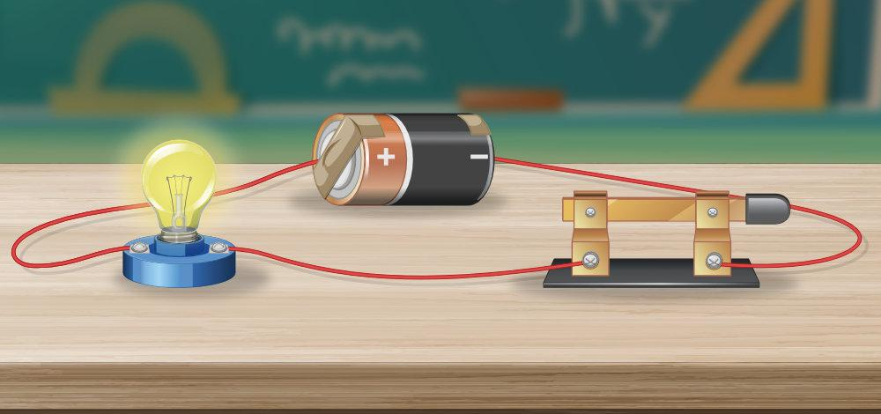
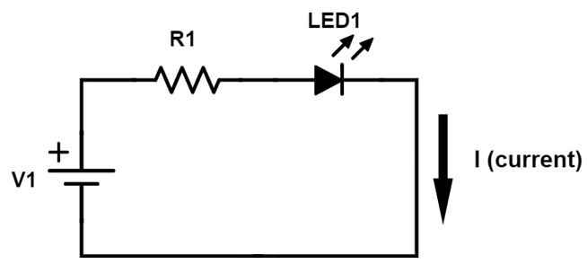
A Hands-On Session with FEMM
What are circuits?

Slide 5
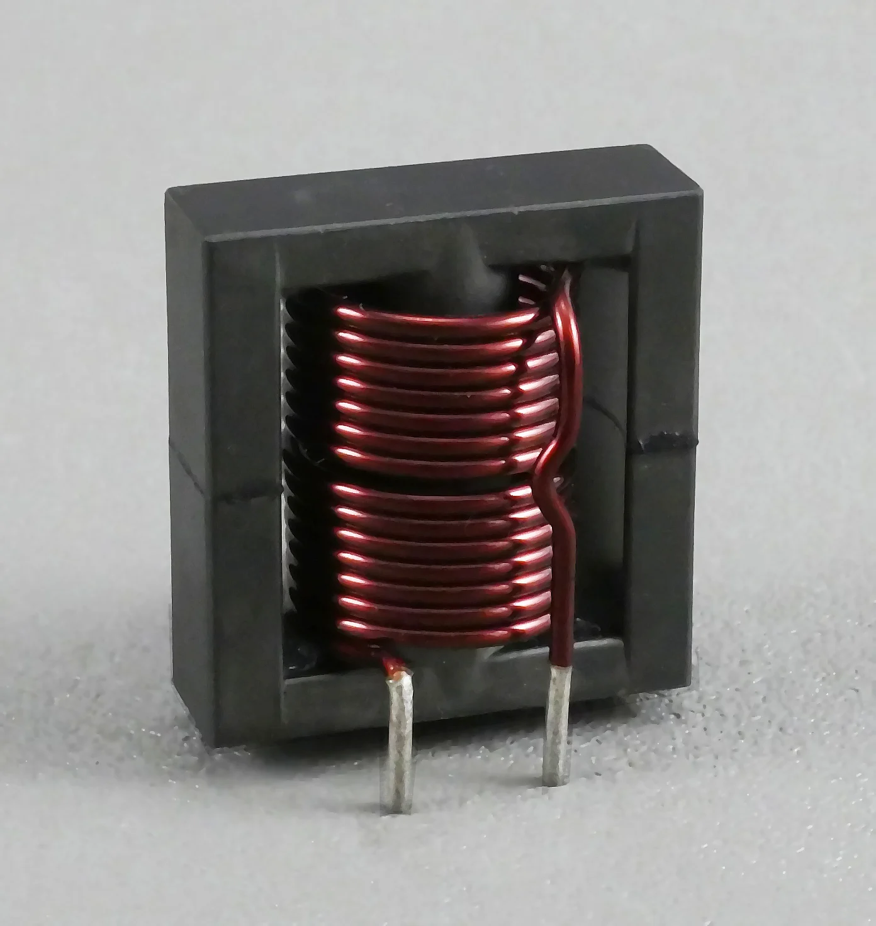
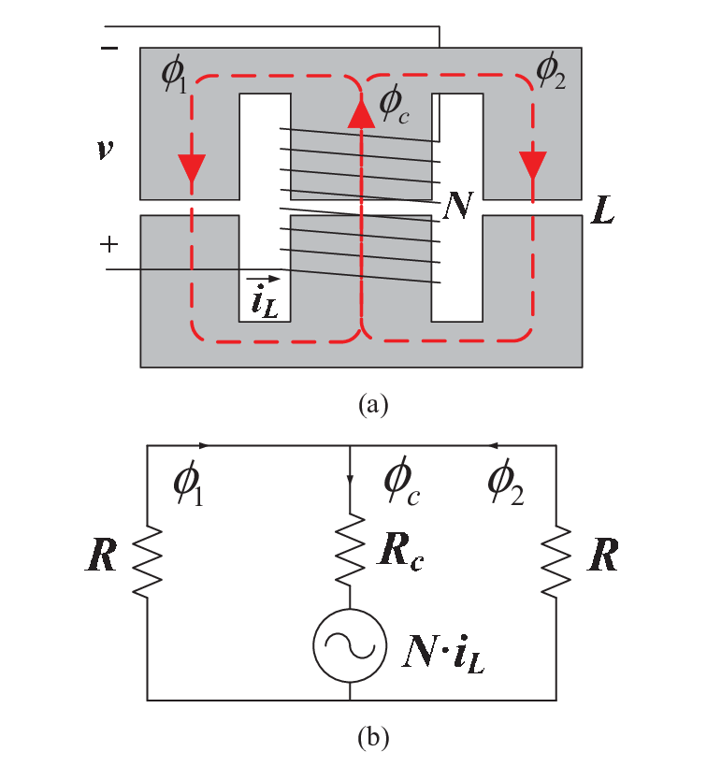
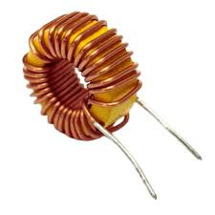
A Hands-On Session with FEMM
What are magnetic circuits?

Slide 6
A Hands-On Session with FEMM
Simple magnetic circuit
Understanding a simple magnetic circuit

Slide 7
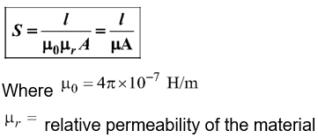
A Hands-On Session with FEMM
Simple magnetic circuit
Calculating the values
Note:-
S/R are interchangeably used to show reluctance

Slide 8
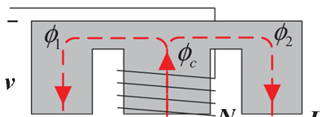
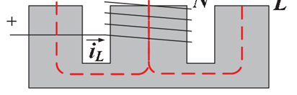
A Hands-On Session with FEMM
Simple magnetic circuit
Understanding practicality

Slide 9
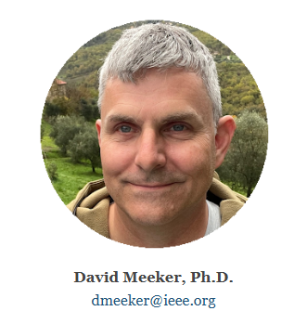

A Hands-On Session with FEMM
Finite Element Method Magnetics - FEMM
About & Installation
Femm SW Icon
https://www.femm.info/wiki/Download
https://www.femm.info/wiki/DavidMeeker

Slide 10
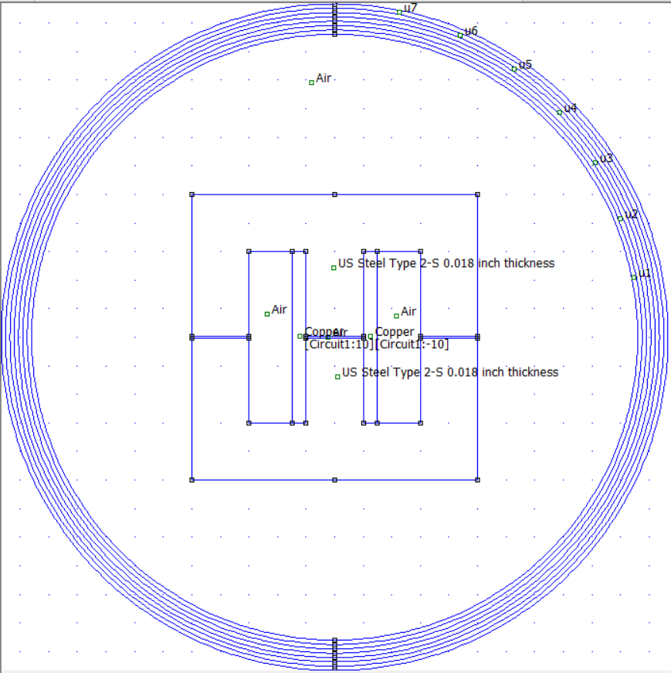
A Hands-On Session with FEMM
Finite Element Method Magnetics - FEMM
FEMM – Modelling

Slide 11
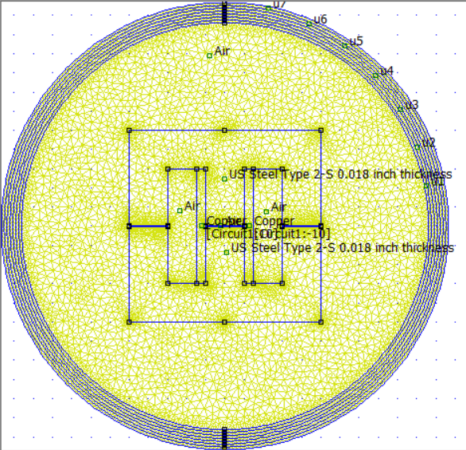
A Hands-On Session with FEMM
Finite Element Method Magnetics - FEMM
Finite Element Method

Slide 12
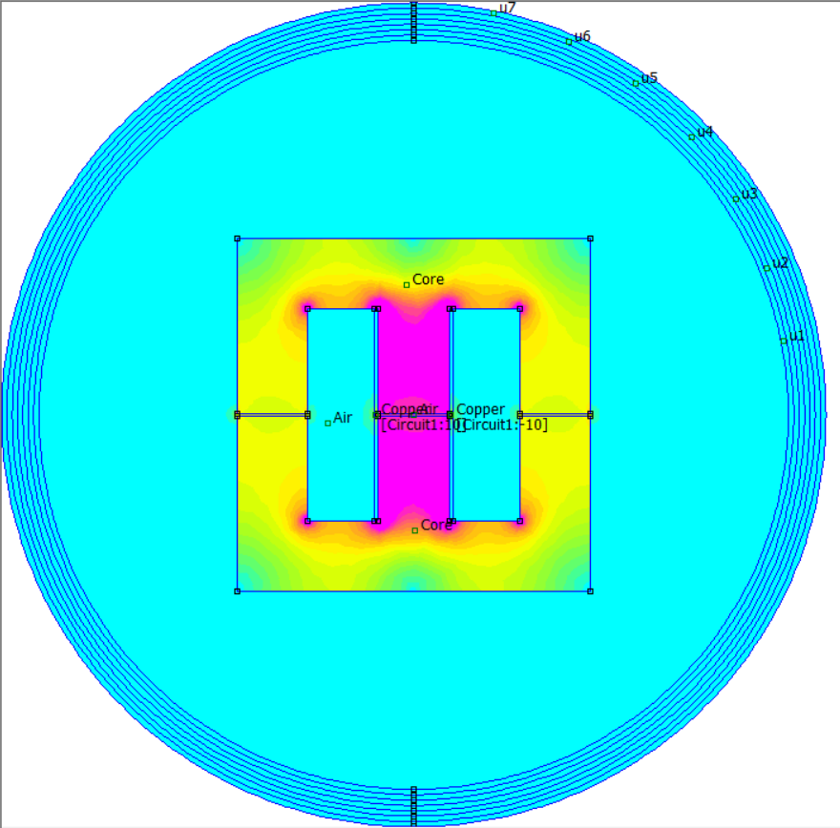
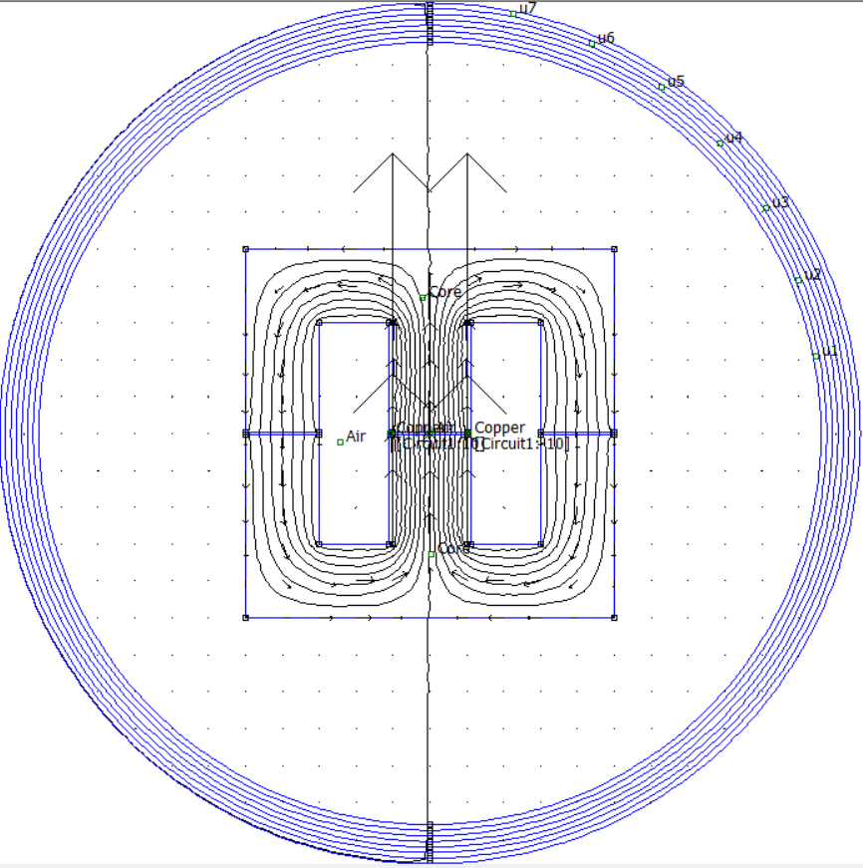
A Hands-On Session with FEMM
Finite Element Method Magnetics - FEMM
Comparison and understanding the results
Please explore more on:
https://www.femm.info/wiki/Documentation/

Slide 13
A Hands-On Session with FEMM
Finite Element Method Magnetics - FEMM
Thank You
- Sai Gopal R

